Slide 1

Presentation on Network Topologies.
Presented by
Moshiur Rahman
ID-1205035
ID-NT/ACSL-01M/R28/01
IDB-BISEW IT Scholarship.

Slide 2
What is Topology
Topology is the method of establishing the connection among the computers for sharing the resources.

Slide 3
Available Topologies
Bus
Star
Ring
Mesh
Point to Point.
Point to Multipoint.
Hybrid
Shortcut: BSRM-PPH

Slide 4
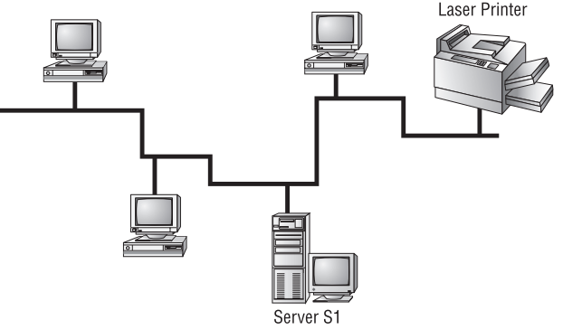
Bus Topology
This topology consists of two distinct and terminated ends, with each of its computer connecting to one unbroken cable running its entire length.

Slide 5
Bus Topology
Advantages:
Easy to install.
Not very expensive.
Disadvantages:
Hard to identifying the fault
Hard to troubleshoot, change or move.

Slide 6
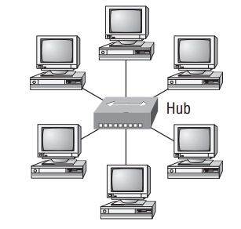
Star Topology
Every computers are connected to a central point with their own cables or wireless connection by a device like switch, hub or an access point.

Slide 7
Star Topology
Advantages:
More widely use.
Using the network segment.
Easy to find the fault.
Add or remove the media.
One fault won’t bring down the entire network.
Disadvantages:
Cost can be higher.
Central Point of failure.

Slide 8
Thank you all

